Slide 1
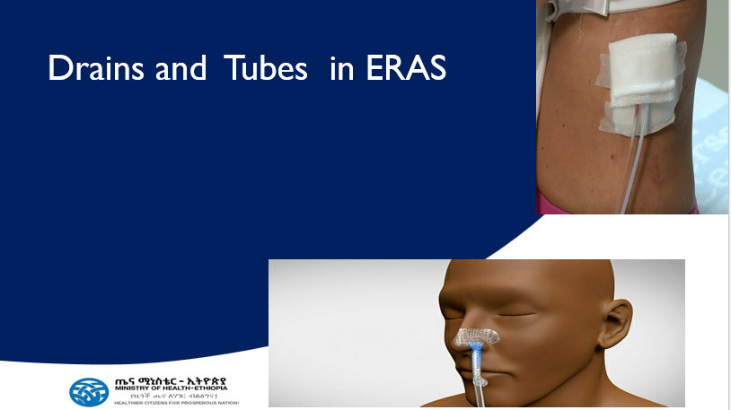

Slide 2
Outline
Objectives
Brainstorming
ERAS Recommendations
Summary

Slide 3
Objectives
At the end of this session, participants will be able to :-
Promote appropriate and evidence-based use of drains and tubes
Practice selective use and early removal of drains and tubes once they serve their intended functions

Slide 4
Brainstorming
What is your personal / your institutional principles/guidelines to put/remove drains and tubes?

Slide 5
Introduction
The basic idea
A surgical drain is essentially a controlled exit path for fluid, blood or pus that may otherwise collect in the operative area
Purpose
To evacuate unwanted collections
Blood → prevent hematoma
Serous fluid → prevent seroma
Pus → treat/prevent abscess recollection
Bile, pancreatic fluid, intestinal contents → early detection of leaks

Slide 6
…Cont’d
Tubes
Nasogastric(NG) tubes, transurethral catheters, T-tubes, Chest tubes
Drains
Purpose
Therapeutic and prophylactic
Sites
Intraabdominal (intracavitary, free -peritoneal, retroperitoneal, retropubic,…),wound-space (e.g Thyroidectomy, Mastectomy, Abscess cavity)

Slide 7
When to Use (General Indications)
After major resections (pancreatic, hepatic)
Near high-risk anastomoses (esophageal, pancreatico-jejunostomy)
After abscess drainage (post-appendicular, diverticular)
Biliary surgery with questionable duct closure or high risk of leak
Trauma surgery where contamination or bleeding risk is high

Slide 8
ERAS recommendations
Selective use (avoid routine use)
Avoiding “Drainomania”
Early removal
Rationale
drains can themselves increase infection risk and delay patient mobility

Slide 9
…Cont’d
“In ERAS, tubes are indications-only and time-limited
If we can’t write the removal trigger when we place it, we probably shouldn’t place it”
“Early oral intake and mobility beat NGs and lines
Every extra day with a tube costs us steps, calories, and independence”

Slide 10
When Not to Use (Avoiding “Drainomania”)
Clean, low-risk cases
elective uncomplicated cholecystectomy, small bowel resection with healthy bowel
When drain placement may injure tissue or create a fistula
Bottom line
In modern abdominal surgery, drains are not a default
— they are a selective, purposeful tool
The decision should always be proactive, not habitual
They are there to protect the patient, not to reassure the surgeon

Slide 11
Nasogastric (NG) tubes
ERAS Default: Avoid routine postoperative decompression; remove before extubation
Routine NG after colorectal surgery delays feeding and adds complications without benefit → don’t do it.
If placed intra-op, take it out at the end. Reinsert only for persistent vomiting/ileus. ASCRS

Slide 12
…Cont’d
Hepato-pancreato-biliary ERAS pathways likewise discourage prophylactic NG tubes.
If you must keep NG tube (e.g., massive gastric distension)
set a clear stop rule
remove when nausea resolves and output <300 mL over 6–8 h
then start sips and advance
Document
why it’s in and
Plan for removal—in the order set

Slide 13
Urinary (Foley) catheters
Remove early to mobilize and lower UTI risk
Colon/rectal resections:
typically remove within 24–48 h
sooner (≈24 h) for colon resections
pelvic dissection patients may need up to POD2–3 given retention risk
avoid “just in case” use of catheters
Practical cues
If thoracic epidural is running or patient is high-risk (male pelvic surgery, BPH, large fluids), aim for a documented postoperative day of removal

Slide 14
Feeding tubes (nasojejunal/jejunostomy)
ERAS : Prefer early oral feeding; avoid prophylactic feeding tubes
After colorectal surgery
start regular diet within 24 h; routine feeding tubes aren’t needed
Consider NJ/J-tube selectively
e.g., malnutrition, anticipated delayed gastric emptying, total gastrectomy/esophagectomy programs, rather than by default
(Practice varies by upper-GI program; still, ERAS emphasizes oral first)

Slide 15
Summary
Minimize the use of drains and tubes
Avoid routine use
Plan early removal
Specific guidelines vary by surgical procedure and patient specific factors
Make sure drains are NOT source of pain, infection or immobilization

Slide 16


Slide 17
Prophylactic Intra-abdominal Drains in Major Elective Surgeries: A Comprehensive Review
Sai Goutham Rekavari ^{1,✉}, Chanrashekhar Mahakalkar ¹
Editors: Alexander Muacevic, John R Adler
Author information
Article notes
Copyright and License information
PMCID: PMC10933947 PMID: 38481916

Slide 18
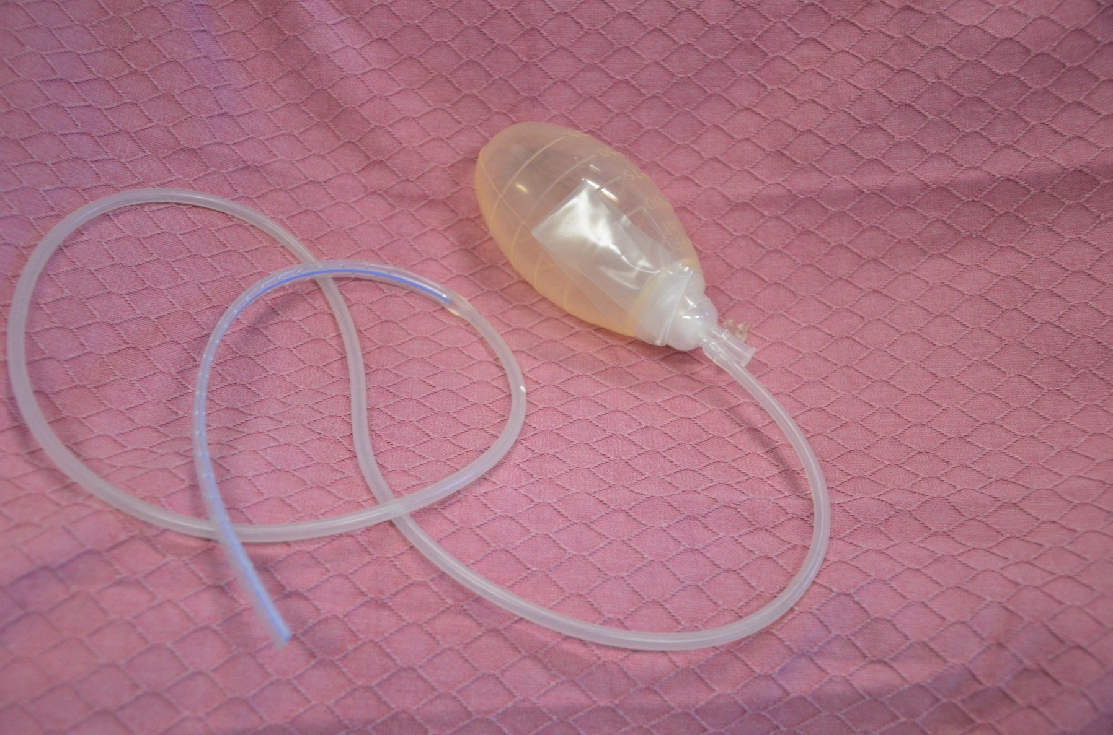
This Photo by Unknown Author is licensed under CC BY

Slide 20
Delayed ambulation in adult patients after major abdominal surgery in Northwest Ethiopia: a multicenter prospective follow up study
Simachew Amogne Debas,
Wubie Birlie Chekol,
Mulualem Endeshaw Zeleke &
Abraham Tarekegn Mersha
Scientific Reports volume 15, Article number: 13382 (2025) Cite this article
1722 Accesses
Metrics

Slide 21
Systematic review and meta-analysis of the efficacy of prophylactic abdominal drainage in major liver resections
Sepehr Abbasi Dezfouli,
Umut Kaan Ünal,
Omid Ghamarnejad,
Elias Khajeh,
Sadeq Ali-Hasan-Al-Saegh,
Ali Ramouz,
Roozbeh Salehpour,
Mohammad Golriz,
De-Hua Chang,
Markus Mieth,
Katrin Hoffmann,
Pascal Probst &
Arianeb Mehrabi
Scientific Reports volume 11, Article number: 3095 (2021) Cite this article
3412 Accesses
26 Citations
1 Altmetric
Metrics
Major liver resection is considered the treatment of choice in patients with large and multiple lesions¹. Procedure-related complications can occur following major hepatectomy, and despite remarkable improvements in the surgical technique, morbidity rates remain high². Prophylactic drain insertion has been a routine practice in abdominal surgery. These drains are inserted to detect and characterize bleeding or abdominal collections early on and to prevent and manage postoperative fluid collection³. However, in recent years, this widespread practice has been abandoned as a routine part of many operations, such as cholecystectomy⁴, pancreatic surgery⁵, and standard bowel resections⁶. Innovations in imaging techniques and advancements in various diagnostic tests have made it possible to identify fluid collections without a prophylactic drain. When necessary, these complications can be managed with interventional percutaneous drainage.

Slide 22
Prophylactic Intra-abdominal Drains in Major Elective Surgeries: A Comprehensive Review
Sai Goutham Rekavari ¹, Chanrashekhar Mahakalkar ¹
Affiliations Expand
PMID: 38481916
PMCID: PMC10933947
DOI: 10.7759/cureus.54056
Abstract
This comprehensive review explores the use of prophylactic intra-abdominal drains in major elective surgeries, offering a retrospective analysis of their historical evolution, current evidence, and implications for clinical practice. The definition and rationale for drain placement are elucidated, emphasizing their role in preventing postoperative complications. The review synthesizes conflicting evidence, acknowledging the efficacy of drains in specific surgical contexts while addressing concerns and criticisms regarding associated complications. The implications for clinical practice underscore the importance of a nuanced and individualized approach, incorporating shared decision-making between healthcare providers and patients. Looking ahead, areas for future research are identified, including the refinement of patient selection criteria, determination of optimal timing and duration of drain use, and exploration of innovative alternatives. This review contributes to the ongoing discourse as surgical practices evolve, providing insights that may shape evidence-based recommendations and refine best practices in major elective surgeries.
Keywords: clinical practice; evidence-based recommendations; major elective surgeries; postoperative complications; prophylactic intra-abdominal drains; shared decision-making.
Copyright © 2024, Rekavari et al.
PubMed Disclaimer
Conflict of interest statement
The authors have declared that no competing interests exist.

Slide 23
Early removal of prophylactic drains reduces the risk of intra-abdominal infections in patients with pancreatic head resection: prospective study for 104 consecutive patients.
Kawai M ¹,
Tani M ,
Terasawa H ,
Ina S ,
Hirono S ,
Nishioka R ,
Miyazawa M ,
Uchiyama K ,
Yamaue H
Author information
Annals of Surgery, 01 Jul 2006, 244(1):1-7 https://doi.org/10.1097/01.sla.0000218077.14035.a6 PMID: 16794381

Slide 24
Review Article
Safety and efficacy of using prophylactic drainage after intra-abdominal surgeries: An umbrella review of systematic review and meta-analysis studies
Author links open overlay panelAhmad Yamen Arnaout ª, Hassan Alhaj Ali ª, Yaman Nerabani ª, Mohamad Yahia Fallaha ª, Abd Alazeez Atli ª, Joudi Tarabishi ª, Rima Salem ª, Khaled Arnaout ª, Lama Kadoura ^{b}, Ahmad Ghazal ^{b}
Show more
Add to Mendeley
Share
Cite
https://doi.org/10.1016/j.ijso.2022.100545

